Slide 1
The Graduate School
Biomedical Sciences
Research, Training and Innovation
Dwayne Godwin, PhD
Interim Dean

Slide 2
Outline
Current Snapshot
Recent History
Current State
Next year

Slide 3
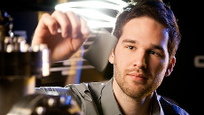
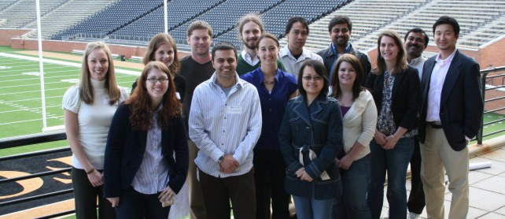

Slide 4
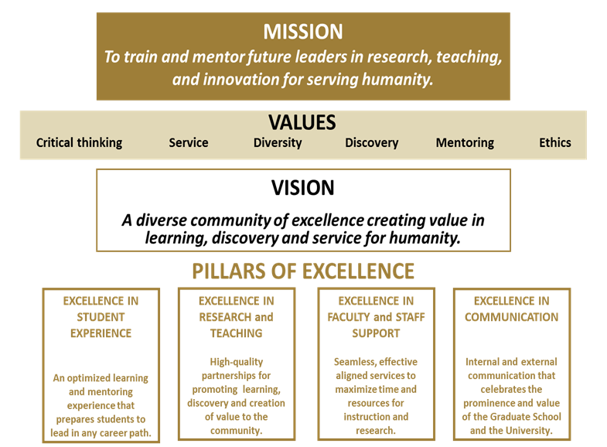
Graduate School Mission and Values

Slide 5
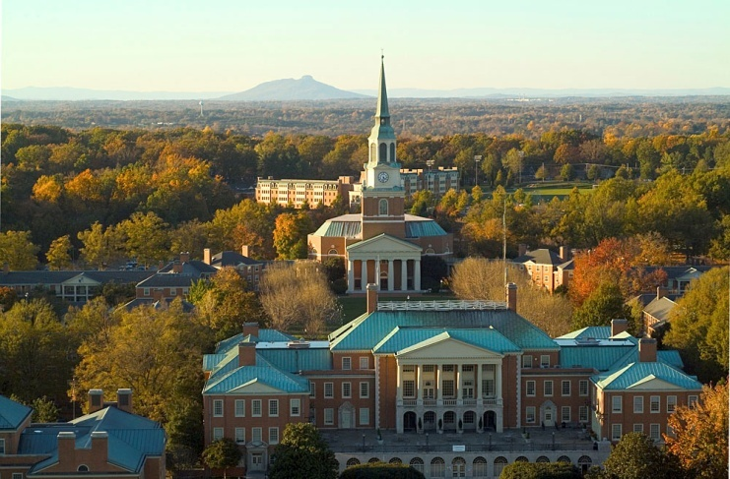
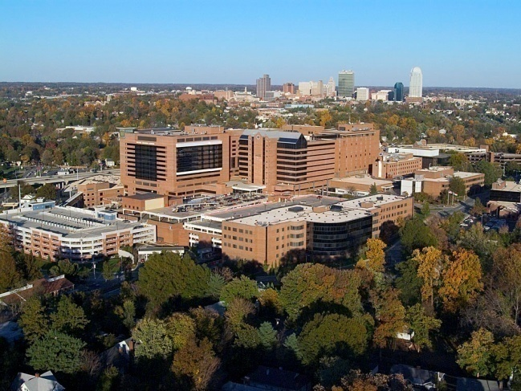
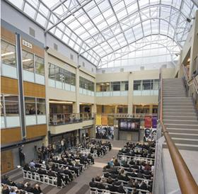
Graduate School of Arts and Sciences
789 Graduate students:
370 master’s, 38 unclassified
381 doctoral
75% at Biomedical
25% at Reynolda Campus
~250 Postdoctoral Fellows
(~565 Medical and Physician Asst. Students)
Reynolda
Bowman Gray
Biotech Place
Primate Center

Slide 6
Student Profile
Male (43%)
Female (57%)
Domestic (79%)
Minority (16%)
International (21%)
Time to PhD completion 5.4 yrs

Slide 7
Outline
Current Snapshot
Recent History
Current State
Next year

Slide 8
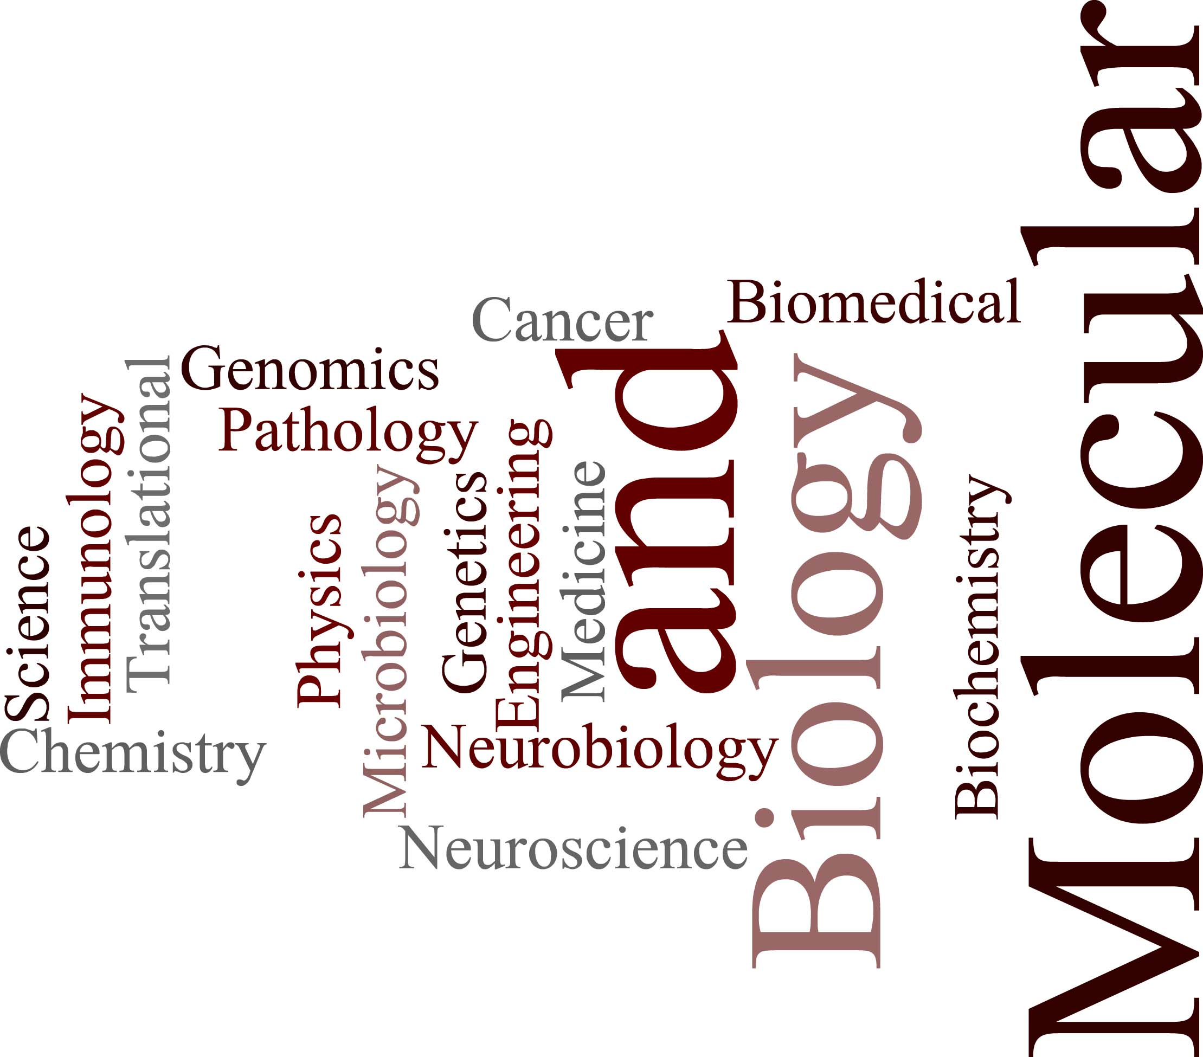
PhD Programs (2009)
2009

Slide 9
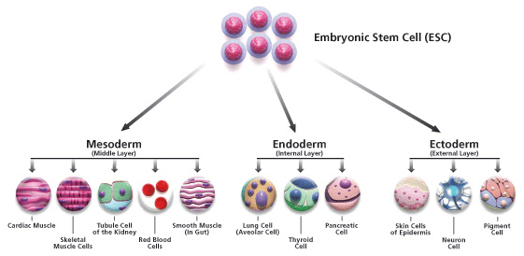
A Metaphor
Interdisciplinary
Tracks
Department
Based
Training
PhD

Slide 10
PhD Programs (2011)
Years 1-2
Thesis Years
Physical and Biological Sciences
Biology
Biology
Chemistry
Chemistry
Physics
Physics
Application
Biomedical Sciences
Biochemistry
Cancer Biology
Micro/Immunology
Molecular Genetics/Genomics
Molecular Medicine
Molecular Pathology
Molecular and Cellular Sciences
Integrated Physiology and Pharmacology
Physiology/Pharmacology
Neurosciences
Neuroscience
Neurobiology and Anatomy
Physiology/Pharmacology
Biomedical Engineering
Biomedical Engineering

Slide 11
Outline
Current Snapshot
Recent History
Current State
Next year

Slide 12
Biomedical PhD Programs (2012)
Years 1-2
Thesis Years
Biochemistry
Cancer Biology
Micro/Immunology
Molecular Genetics/Genomics
Molecular Medicine
Molecular Pathology
Molecular and Cellular Biosciences
Integrated Physiology and Pharmacology
Physiology/Pharmacology
Application
Neuroscience
Neurobiology and Anatomy
Physiology/Pharmacology
Neurosciences
Biomedical Engineering
Biomedical Engineering

Slide 13
Working across disciplines
Several current NIH training grants:
- Alcoholism - Neuroscience (3)
- Cancer biology - Molecular medicine
- Drug abuse - Microbiology and immunology
- Lipid science and inflammation
- PREP, EICS - Radiation Oncology (TRADONC) T32, postdoctoral
At least 3 in process:
- Regenerative Medicine, IRACDA (postdocs), EICS (renewal)
The Graduate School supports these with boilerplate text, data collection for tables, letters of support, and often direct grant writing. Commitment to finish the installation of the Training Grant Repository which was stalled.

Slide 14
Joint Degrees:
MD/PhD - with the WFU School of Medicine
PhD/MBA - with the WFU Schools of Business
Unique Training:
Translational Science
Internships with industry
Training through the Translational Science Institute
Teaching assistant workshops
Extensive, multiyear engagement with Professional Development and Responsible Conduct of Research

Slide 16
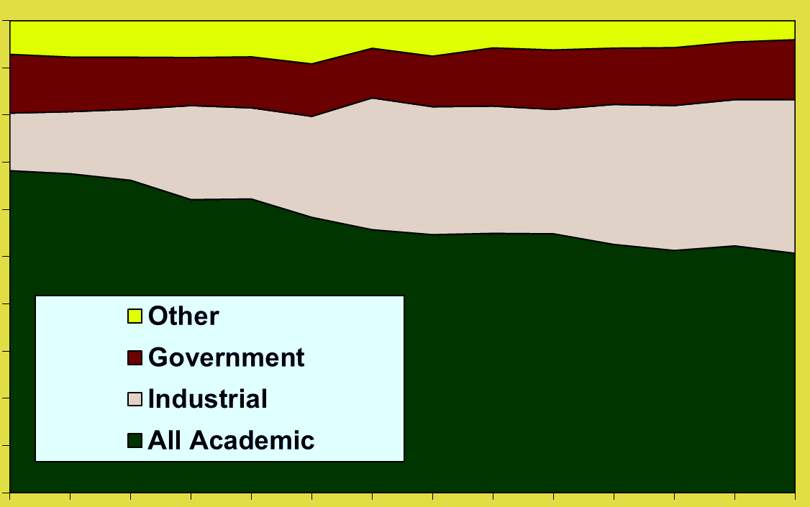
Distribution of Biomedical Science PhDs by Sector of Employment
100%
50%
1973
2006
Source: http://sestat.nsf.gov/
Notes:
Employment Status of Individuals with Ph.D.s from U.S. Institutions
Source:
National Science Foundation
Survey of Doctorate Recipients
For information on the survey: http://www.nsf.gov/statistics/srvydoctoratework/
For data access: http://sestat.nsf.gov
Survey Characteristics
The Survey of Doctorate Recipients (SDR) administers an extensive battery of questions to a stratified random sample of Ph.D. recipients from U.S. doctorate granting institutions. This panel survey interviews members of the sample at regular intervals, offering a unique perspective on career progression.
Survey Dates: 1973, 1977, 1981, 1985, 1989, 1991, 1993, 1995, 1997, 1999, 2001, 2003, 2006
Field Specifications Used for These Tabulations:
1973 – 1993
Biomedical science: Anatomy, Bacteriology, Biochemistry, Biometrics and Biostatistics, Biophysics, Biotechnology Research, Cell Biology, Developmental Biology/Embryology, Endocrinology, Genetics, Animal and Plant, Genetics, Human and Animal, Hydrobiology, Immunology, Microbiology, Microbiology and Bacteriology, Molecular Biology, Neuroscience, Nutritional Sciences, Parasitology, Pathology, Human and Animal, Pharmacology, Human and Animal, Physiology, Human and Animal, Toxicology, Zoology, Biological Sciences, General, Biological Sciences, Other
1993 (NEW) - 2006
Biomedical doctorate holders are doctorates from U.S. universities who received degrees in the following fields: biochemistry and biophysics; biology, general; cell and molecular biology; genetics, animal and plant; microbiological sciences and immunology; nutritional sciences; pharmacology, human and animal; physiology and pathology, human and animal; zoology, general.
Survey Notes: Since 1993, the response rates for the surveys have ranged between 77 and 87 percent.
Key variables include: Citizenship status, Country of birth, Country of citizenship, Date of birth , Disability status, Educational history (for each degree held: field, level, institution, when received), Employment status (unemployed, employed part time, or employed full time), Geographic place of employment, Immigrant module (year of entry, type of entry visa, reasons) for coming to U.S., etc.), Marital status, Number of children, Occupation (current or past job) Primary work activity (e.g., teaching, basic research, etc.), Postdoctorate status, Publication and patent activities, Race/ethnicity, Salary, Satisfaction and importance of various aspects of job, School enrollment status, Sector of employment (e.g., academia, industry, government, etc.), Sex, and Work-related training
Includes US citizens and permanent residents only.
Contact Information:
Nirmala Kannankutty Senior Analyst Human Resources Statistics Program Division of Science Resources Statistics National Science Foundation 4201 Wilson Boulevard, Suite 965 Arlington, VA 22230 E-mail: nkannank@nsf.gov

Slide 17
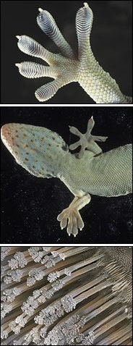
Innovation Focus
PhD/MBA Program
Certificate in Science Management
Industry Internships
OTAM Internships
Partnerships with IEI
(Commercializing Innovation, Regulatory classes)
A knowledge economy requires a workforce with knowledge.

Slide 18
Wake Forest Graduate School Innovation Curriculum
Basic
GRAD 704 (Principles of Intellectual Property Development)
GRAD 702 Industry Internships
Intermediate
ENT5450 Commercializing Innovation
GRAD 703 Industry Internships
Advanced
Professional
Certificate in Science Management (Stackable certificate)
PhD/MBA Program (Dual professional credential)
GRAD 701 Seminar in Professional and Career Development*
GRAD 713, 714 Scientific Professionalism and Integrity*
Years 1-2
Years 2-3
Years 3-5
* Required of all 1st year students

Slide 19
Outline
Current Snapshot
Recent History
Current State
Next year

Slide 20
“Determine the thing that can and shall be done, and then we shall find the way.”
- Abraham Lincoln

Slide 21
Committees:
I. Graduate Structure Committee (Early spring)
a. Recommendations of either status quo or current bicameral model
b. Current “bicameral” structure includes Biomedical and Arts and Sciences Deans
(Term is for the current academic year. No decision yet on what comes after.)

Slide 22
Committees (cont’d):
II. Graduate Finance Committee (Late spring)
Charged to examine flow of funds, propose strategies to close gap to offset graduate EVUs.

Slide 23
Recommendations:
Consider a policy for discounted tuition to be charged to research grants, to be phased in with new grants.
Explore the potential of Master’s programs for which students will pay tuition.
Work to enhance current revenue-generating activities.
Salary support should be provided for faculty involved in graduate teaching and administration.
Improve student learning experience as well as the efficiency of faculty effort.
Increased support for graduate training programs and postdoctoral programs.

Slide 24
Graduate School Actions:
Faculty task forces for tuition, Master’s, and education recommendations. Charges drafted. (Sept 2012)
Commitment to provide needed programming to complete the Curvita installation. (Fall 2012)
Positive funds flow will be administered for faculty “gEVUs” by the Graduate School. Contingent on (1).

Slide 25
New Students Have Arrived
Emphasis on mentoring (advisor and peer based)
Graduate courses, professional seminars
Research resources
Grants, fellowships, and other funding opportunities
Career and professional services
Graduate Student Organizations and Networking
Fostering interdisciplinary collaboration within and across academic units
The trains continue to run on time.

Slide 27
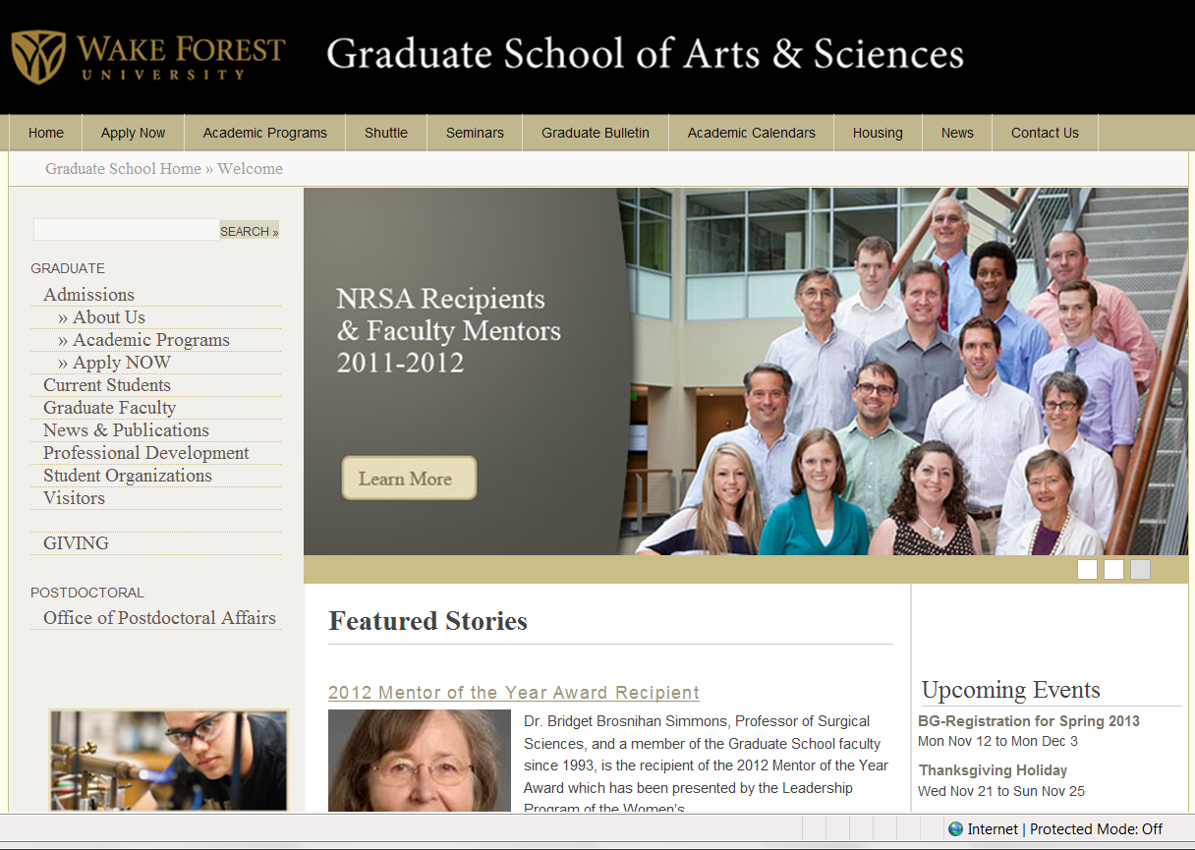

Slide 28
“ Patience and perseverance have a magical effect before which difficulties disappear and obstacles vanish.”
- John Quincy Adams

